Slide 1

Rockbuster
Maverick Figueira

Slide 2
Agenda
Primary goals
Countries
Loyal Customers
Rental Duration
Summary
Presentation Title

Slide 3

Primary Goals
Rockbuster is looking to transition to a streaming service to compete with Netflix, Amazon, Hulu, and other notable streaming services. They have movie licenses that they can utilize and increase their revenue. They are taking steps not to follow Blockbuster’s footsteps.
Rockbuster supplied the BI team with inquiries to look for.
● Which movies contributed the most/least to revenue gain?
● What was the average rental duration for all videos?
● Which countries are Rockbuster customers based in?
● Where are customers with a high lifetime value based?
● Do sales figures vary between geographic regions?

Slide 4
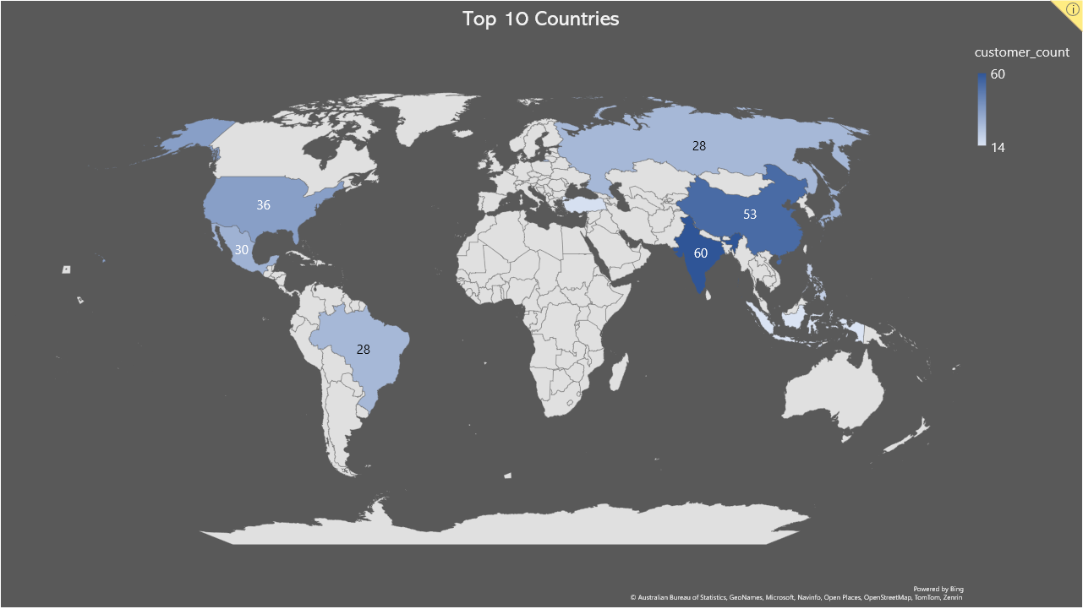
Looking At the Globe
Rockbuster’s highest revenue countries are
India
China
United States
Japan
Mexico
Brazil
Russian Federation
Philippines
Turkey
Indonesia

Slide 5
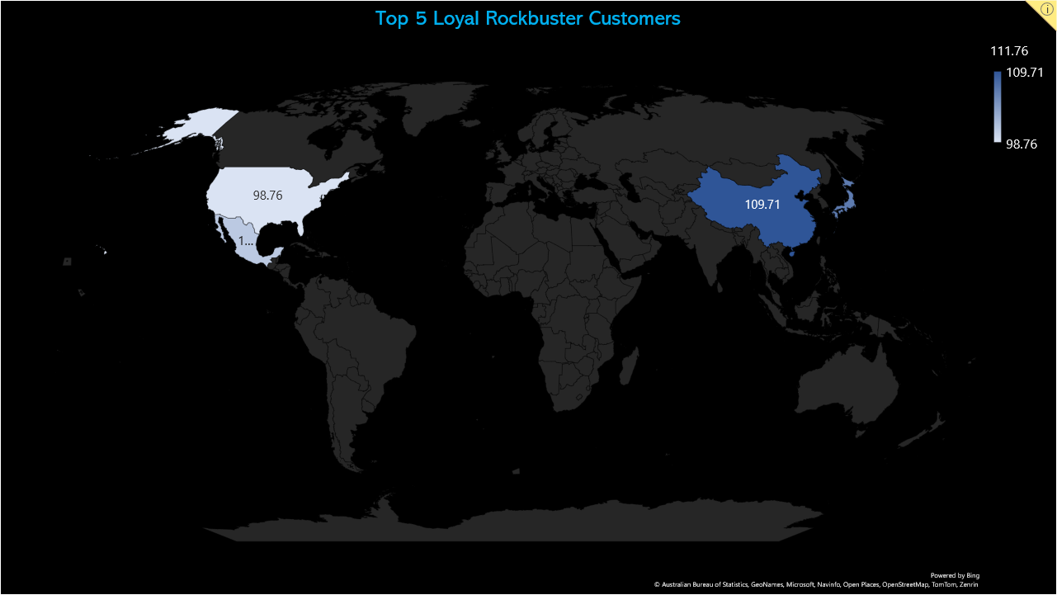
Countries Are Nice, But What About Our Loyal Customers?
Arlene - India
Kyle - China
Marlene - Japan
Glen - México
Clinton - United States
These 5 customers, in descending order, have used Rockbuster’s services the most. It would be great a incentive if we offered them a deal for the streaming service to reward their loyalty.

Slide 6

Rental Duration
Minimum Rental Duration – 3 days
Maximum Rental Duration – 7 days
Average Rental Duration – 5 days
Highest Rented Movie
Academy Dinosaur

Slide 7
We can see that the two highest ratings are PG-13 and NC-17. Then, we have G as the lowest rented rating.
Then if we look at our units sold by Genre, our top 2 genres are sports and foreign. Then the least rented genre is thriller.

Slide 8

Summary
As Rockbuster is moving towards streaming we can use the data that was shown to increase revenue and subscriptions to the service.
First, we should reward the loyal customers by providing them with a free ad-free subscription to encourage them to use the new service.
Next, we need to understand that most of Rockbuster’s market is in Eastern countries. While the United States has a market, most of Rockbuster’s resources should cater to Eastern cultures. We should focus our resources there before we begin to expand.
Rockbuster should also focus on retaining PG-13 and NC-17 movies/TV shows. They should also focus on retaining and expanding their sports and foreign licenses as these are the most rented genres.
Lastly, it is essential to look at other competitors in the streaming market for the cost of their subscriptions. There is an ad subscription and a free subscription. With Rockbuster's current inventory and low total units rented, we should enter a low 5$ for an ad subscription and 10$ for an ad-free subscription.

